Slide 1
SalesGenie AI – AI Sales Assistant & Lead Intelligence Platform

Slide 2
Project Statement
Modern sales teams spend a significant amount of time researching prospects, analysing company information, preparing outreach messages, tracking customer interactions, and identifying high-potential opportunities.
Manual lead qualification and sales outreach often result in inconsistent engagement, lower conversion rates, and reduced productivity.
This project aims to develop SalesGenie AI, an AI-powered Sales Assistant and Lead Intelligence Platform that automates lead analysis, prospect research, personalized outreach generation, sales conversation summarization, and follow-up recommendations.
By leveraging Large Language Models (LLMs), agentic AI workflows, CRM integrations, and sales intelligence analytics, the platform enables sales teams to focus on relationship building and revenue generation.
The solution improves lead conversion rates, streamlines sales operations, and enhances decision-making through actionable AI-driven insights.

Slide 3
Outcomes
Centralized prospect and lead management platform.
AI-powered company profile analysis and lead intelligence generation.
Personalized cold email and outreach message generation.
Automated lead scoring based on conversion probability.
AI-generated follow-up strategies and sales recommendations.
Meeting and sales conversation summarization.
CRM integration for seamless sales workflow management.
Sales performance analytics and business intelligence dashboard.

Slide 4
Modules to be Implemented
Lead Management & Prospect Database
Lead Intelligence & Company Analysis
AI Outreach Generation
Lead Scoring & Recommendation Engine
Conversation Intelligence & CRM Integration
Dashboard & Sales Analytics

Slide 5
Week-wise Module Implementation & High-Level Requirements
Milestone 1 (Weeks 1–2) – Lead Management & Intelligence Engine
Milestone 2 (Weeks 3–4) – Outreach Generation & Lead Scoring
Milestone 3 (Weeks 5–6) – CRM Integration & Conversation Intelligence
Milestone 4 (Weeks 7–8) – Dashboard & Automation

Slide 6
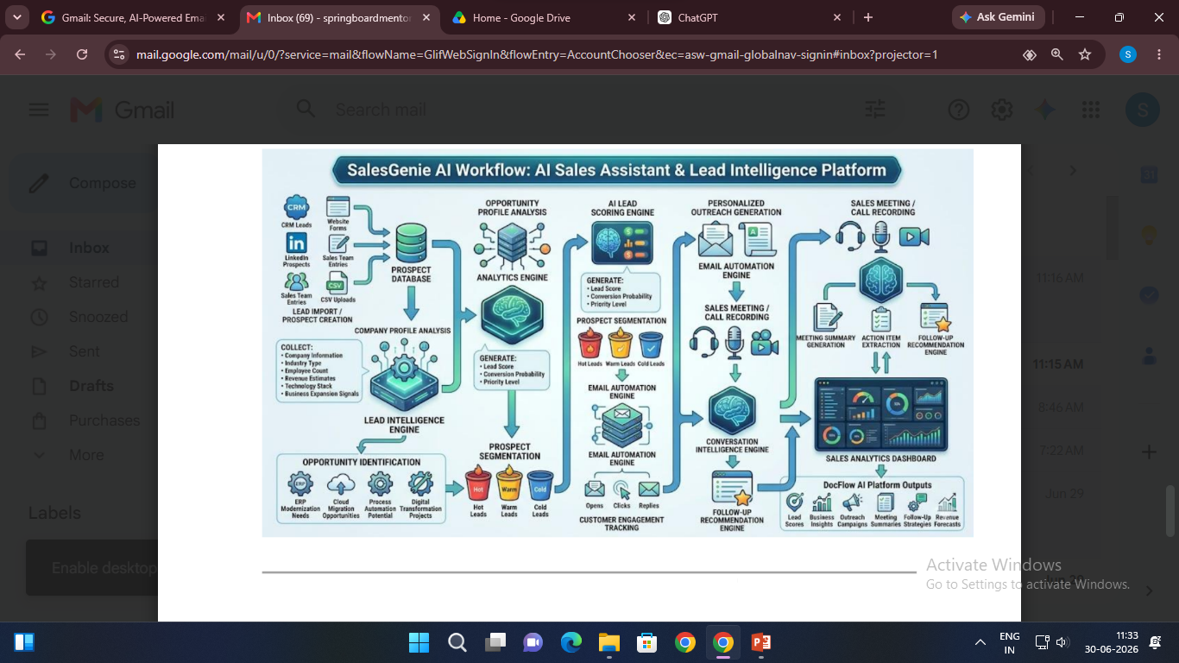
Workflow Diagram

Slide 7
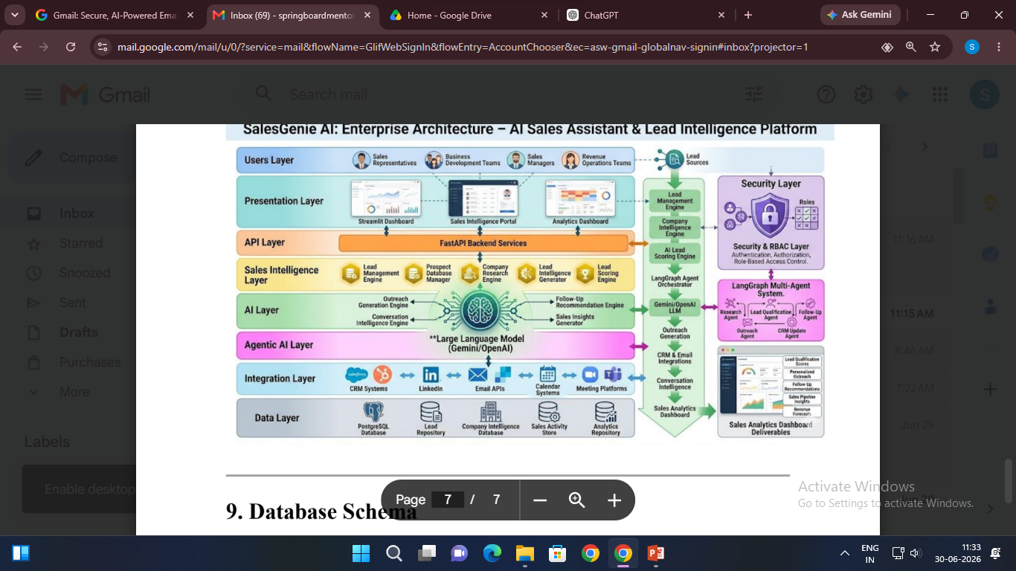
Architecture Diagram

Slide 8
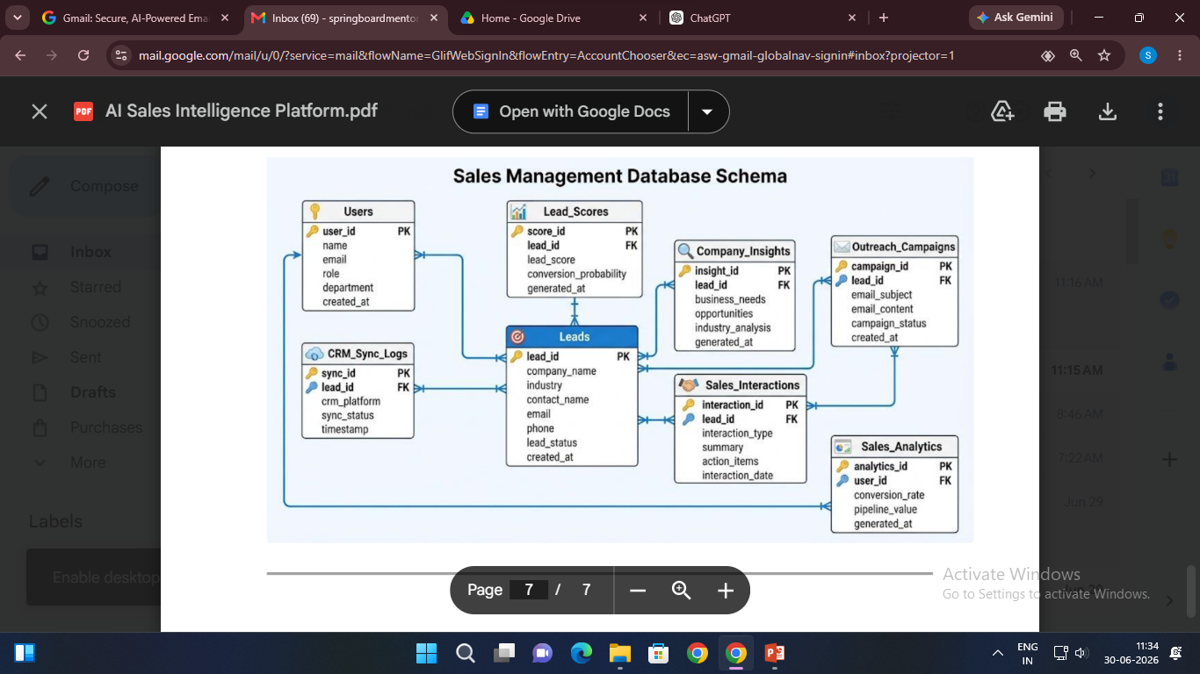
Database Schema

Slide 9
Thank You

